Slide 1

Football Players’ Stats
VA Project a.a. 2021/22
Mauro Ficorella - 1941639
Valentina Sisti - 1952657
Martina Turbessi - 1944497

Slide 2



Why visualize football players’ stats??
Coach of a football club
Helping him deciding which player to ask to his society to buy based on certain specific characteristics
Director of a football club
Helping him choosing the most valuable players on the market based on his budget
Football fan
Helping him to discover new facts and statistics about his favorite football players

Slide 3
Dataset
Preprocessing:
Select only top 5 european leagues
Filter out irrelevant columns
FIFA 22 complete player dataset
Resulting dataset
57 dimensions
2.977 tuples
AS index = 57 x 2.977 = 175.643

Slide 4
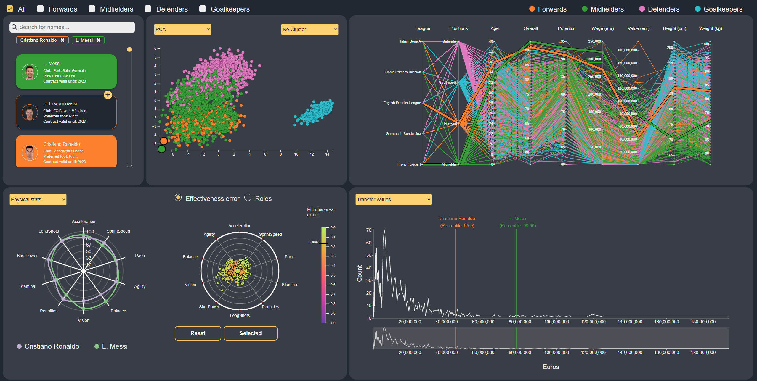
Visual environment

Slide 5
Analytics
Checkboxes
Possibility to select one or more checkboxes to trigger analytics
Recompute from scratch analytics based on the selected roles
Dynamically update each visualization according to the selected roles
All computations are performed on demand through a backend server

Slide 6
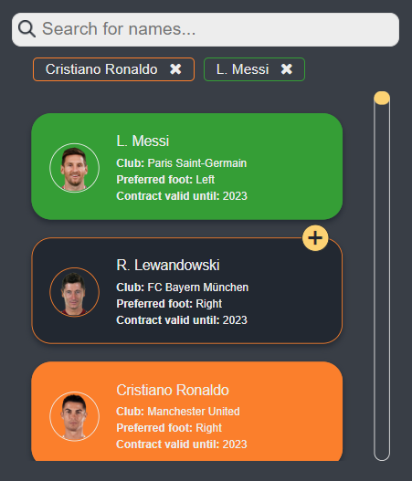
Players‘ list
Cards show a players with certain information about them
Search bar to filter dynamically the players based on their name
The list is interactive with all others visualization, when the user select players
Each color represents a role following the global legend
Indicator for selected player that allows to deselect a player

Slide 7
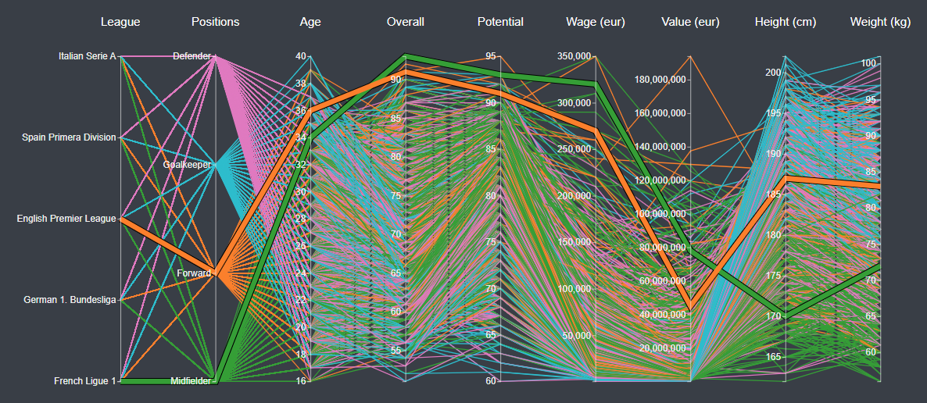
Parallel Coordinates
Line represents a player, intersecting each axis on the corresponding value
Shows relationship between players based on a subset of their attributes
Supports brush on the axis to filter only certain lines, through which interact with list, Scatterplot and RadViz
Shows only attributes that are relevant for the intended users

Slide 8
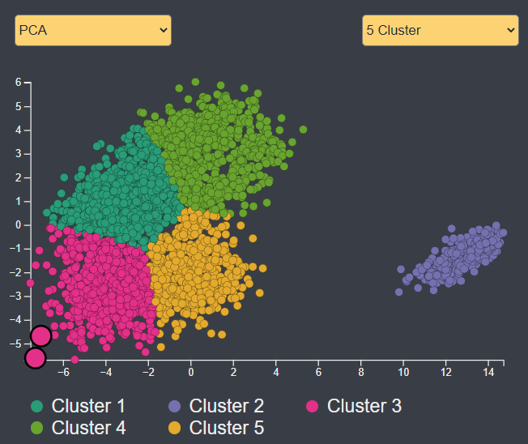
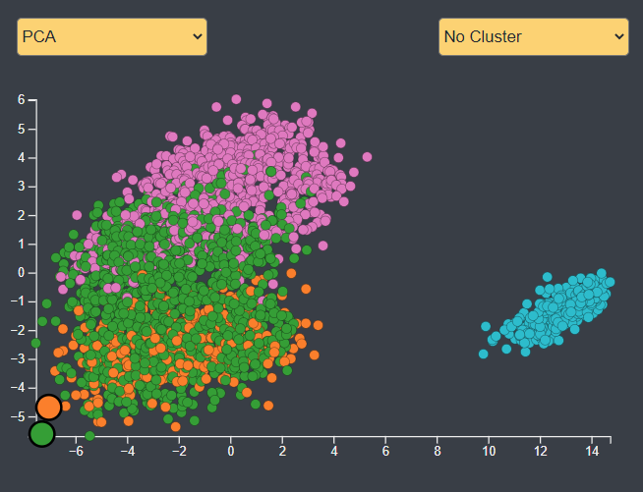
Scatterplot
Circles represent single player
Shows correlation between players after dimensionality reduction result
Clusters’ colors chosen from categorical scheme “d3.schemeDark2”
Legend for clusters’ colors
Possibility to choose between PCA and t-SNE algorithms
Possibility to show clusters
Supports brush, through which interact with list, Parallel Coordinates and RadViz

Slide 9
Scatterplot - Analytics
Dimensionality reduction
For PCA and T-SNE are used only a subset of attributes related to players statistics
PCA
Gives information about players that are far in the original dataset
T-SNE
Gives information about players that have similar characteristics
Better separates data into clusters
Clusterization: K-means
Requires choosing number of clusters in advance
Possibility number of clusters at runtime
Immediate visual feedback

Slide 10
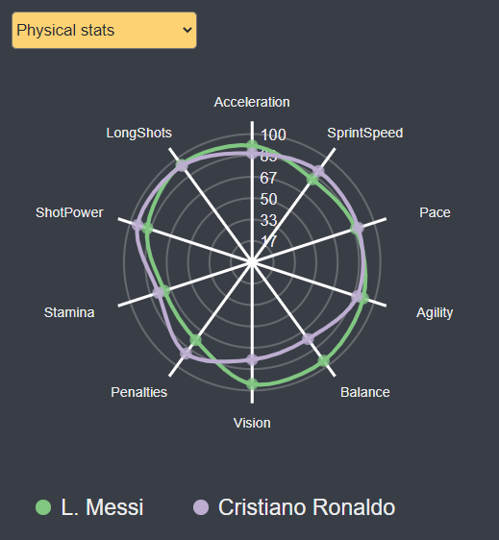
Radar chart
Polygon represents a player
Polygons’ colors chosen from qualitative sets from “ColorBrewer”
Legend for players’ colors
Offers a comparison between players based on their statistics
Possibility to change statistics between physical, attack, defense, keeper and overall

Slide 11
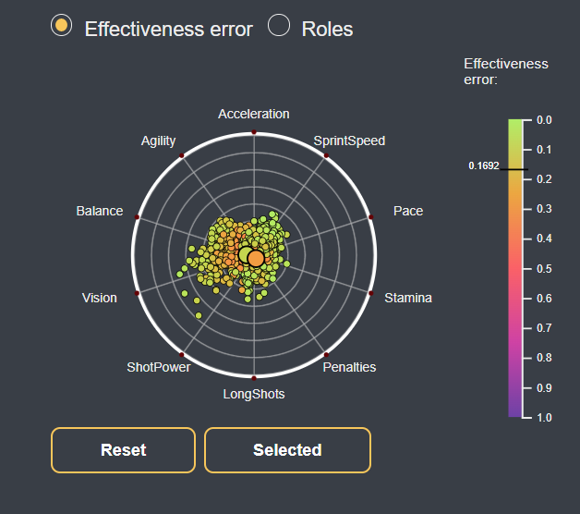
Radviz
Circle represents a player
Shows proportions among players’ attributes
Circles’ colors encode the value of Effectiveness Error or represent players’ role
Legend for Effectiveness Error colors
Possibility to change statistics between physical, attack, defense, keeper and overall
Possibility to optimize heuristic with respect to selected players
Credits: M. Angelini, G. Blasilli, S. Lenti, A. Palleschi and G. Santucci, "Effectiveness Error: Measuring and Improving RadViz Visual Effectiveness," in IEEE Transactions on Visualization and Computer Graphics, DOI: 10.1109/TVCG.2021.3104879.

Slide 12
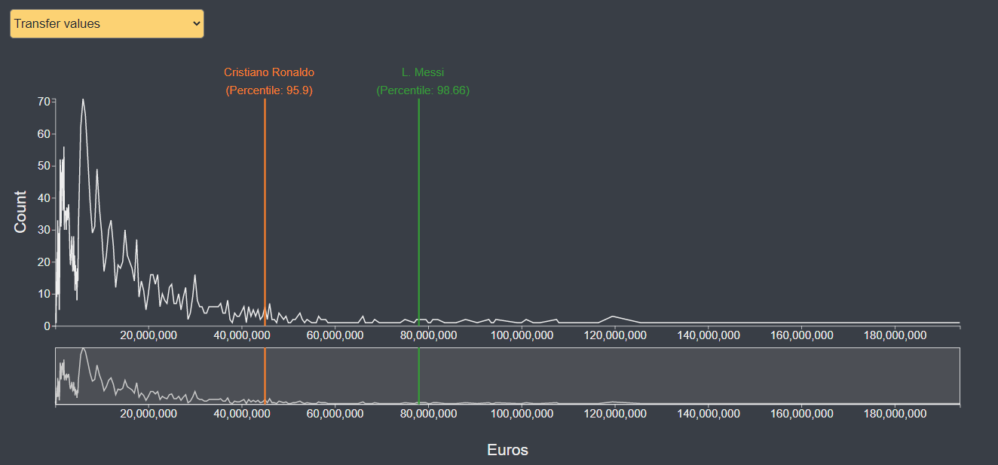
Line chart
Global view of the trend of wage and transfer values represented through line
Small preview below the main graph
Choose transfer or wage values
Vertical line represents the percentile of selected players from the list
Analytics
Computation of numbers of occurrences of players regarding market values or wages
Computation of percentile

Slide 13
Related works
Analyzing In-Game Movements of Soccer Players at Scale
Represent physical performance of players
Compute similarities of players based on movement characteristics rather than through the overall attributes
Find similarities between players using scatterplot through uniqueness and consistency
Soccer Scoop
Measure performance of players and compare them with other players
Intended user are football directors that want to sign players
Focused on numerical values rather than aesthetics

Slide 14
Related works
Transfermarkt and SoFIFA
Both offers interactivity through a simple tooltip in the line chart
SoFIFA offers also a range selector on line chart to zoom on a certain period
Infootmation
Shows statistics about players and lets compare them with the average calculated with respect to all the players
Offers a search bar
Offers radar chart to show player’s overall statistics

Slide 15
Related works
Gaussian mixture clustering model
Uses PCA and model-based gaussian clustering to characterize players
Offers a scatterplot representing the projection of the clusters obtained by their model
Offers radar to represent mean values for each attribute grouped ng the by players’ role

Slide 16
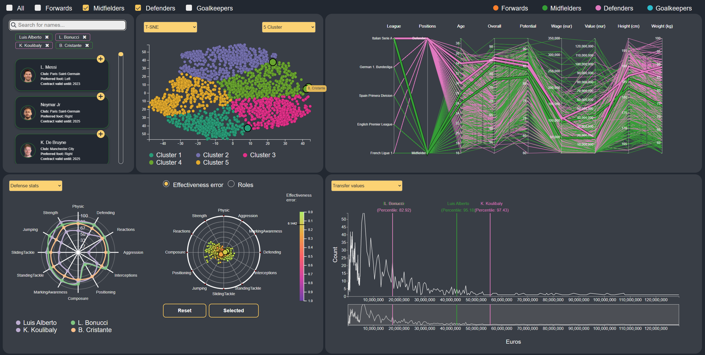
Insights - Correlation between players of different roles

Slide 17
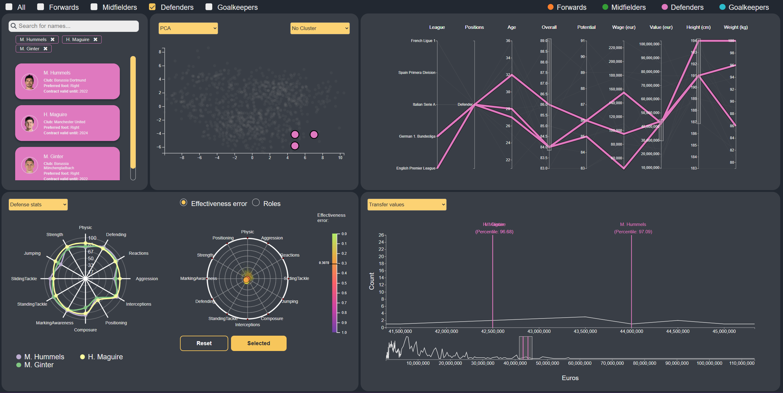
Insights - Spend money on a player wisely

Slide 18
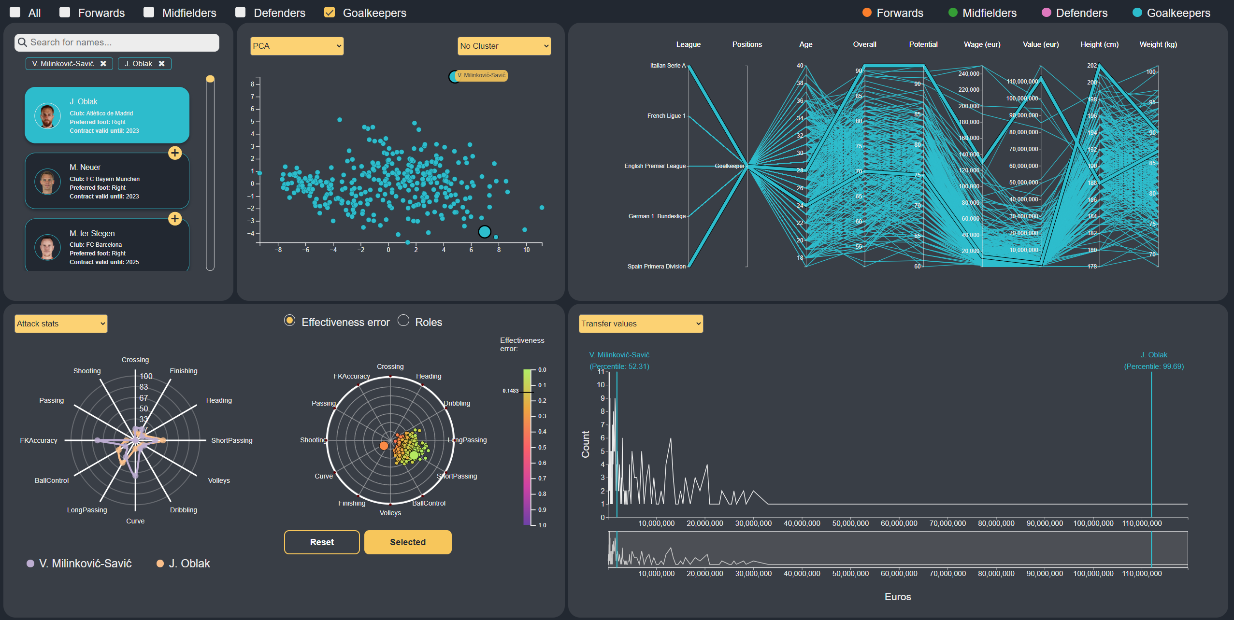
Insights - Discover new facts about players

Slide 19
Conclusions
This work tried to offer an interactive dashboard to all football fans and professionals, taking advantage of multiple visualizations coordinated each other
Users can discover correlations between different players and obtain useful insights
Users can perform on-demand analytics through which they can refine their analysis

Slide 20

DEMO

